Slide 1

ASP.NET Web API 2
Andy Tapaswi
Dot.Net Architect
https://www.linkedin.com/in/andytapaswi

Slide 2
Topics
What is ASP.Net Web API
Little history
When to use WCF and When to use ASP.NET Web API
Is this REST?
New Features of ASP.NET Web API 2
Demo

Slide 3
What is ASP.NET Web API
A fully supported and extensible framework for building HTTP based endpoints
Built on top of ASP.NET
Version 1.0 released along with MVC 4 in August 2012
Current version is 2, released with ASP.NET MVC 5 (on Dot.Net 4.5 and above) on October 2013

Slide 4
History of ASP.NET Web API
WCF 1.0 came up with SOAP based endpoints over Http
WCF 2.0 introduced WebHttpBinding for non-SOAP endpoints over Http
ASP.NET Web API 1.0 was introduced with MVC 4
ASP.NET Web API 2.0 was introduced with MVC 5
Notes:
WCF 1.0 – First true Service Oriented Approach from Microsoft
It provided SOAP based endpoints over Http
But industry was looking for a simple solution for non-SOAP endpoints over Http, SOAP was too verbose and can’t communicate with all types of clients (mobile / appliance / HTML5 based web)
WCF 2.0 along with Dot.Net 3.5 introduced WebHttpBinding for non-SOAP endpoints over Http
SOAP protocol is message based, can’t leverage all the powers of Http
SOAP is not optimized for leveraging Http based caching, Http based compression, Http based actions
All these things were happening in a world where Http was very mature after serving web for many many years
At the same time, ASP.NET team was developing many Http based features for web and all these could be very well leveraged in Http based service stack. But if we stay within the WCF framework which is geared towards SOAP, we can’t easily leverage those benefits
Asp.Net Web Api 1.0 was introduced from the ASP.NET group
It came up with ASP.NET MVC 4.0
Asp.Net Web Api 2.0 was introduced from the ASP.NET group along with MVC 5
ASPNET Web API built on MVC stack but it is nothing to do with MVC, it can also be used in ASP.NET Form based application

Slide 5
Should I use WCF or ASP.NET Web API
Use WCF, if you are limited to Dot.Net 3.5
Use WCF, if you are exposing SOAP based services
Use WCF, if you need to support multiple protocols
Use ASP.NET Web API, if you need to reach wider and diverse cross platform clients / devices
Use ASP.NET Web API, if you need to scale like web and leverage the benefits of Http
Notes:
No doubt that the industry trend is to build ASP.NET web API and certainly, the WCF Http model programming still exists. Now where to use WCF and where ASP.NET Web API?
Questions to ask?
What is the knowledge base of my developers – WCF or ASP.NET?
Are we limited to Dot.Net 3.5?
Do we need to support multiple protocols - TCP, NetPipe, MSMQ etc?
Do we need to support cross platform clients? Do we need to reach wider and diverse audiences / clients? (Mobiles / browsers / devices)
Devices such as – mobile, handheld communicator, set top box, TV or anything – that doesn’t speak SOAP but understand Http
Do we need to scale like the way web scales / in other words, do we need to leverage Http actions / caching / ability to scale like web?
Some corner cases that
Transaction – by default Http doesn’t have any transaction specification but SOAP supports WS-* atomic transactions, so use WCF to maintain transaction across web services
Message level security is necessary if there are network intermediaries (Web API is good is for Point to Point solution)

Slide 6
Is this REST?
REST is an architectural style
ASP.NET Web API doesn’t dictate an architectural style
However, we can build a RESTful service on top of ASP.NET Web API
Notes:
REST – Representational State Transfer
Architecture style for building client server application
REST is introduced by Roy Fielding (Irvine University in California)
REST takes advantages of Web
Resource is addressable by URIs
Uniform Interface convention (GET – selects / POST – creates / PUT – updates / DELETE)
GET – retrieves resource , should be idempotent (Same response if repeated)
POST – Creates, similar to SOAP – unsafe
PUT – Updates and should be idempotent
DELETE – removes a resource and should be idempotent
Stateless to scale easily
Hypermedia – driven (i.e links to next page / new resource created)
Cache - ability

Slide 7
Getting started with ASP.NET Web API 2
Available as standalone NuGet packages
Ships with Visual Studio 2013 Preview
Notes:
Install the ASP.NET and Web Tools 2013 Preview Refresh to get additional features and enhancements
Supported on .NET 4.5 and beyond
See the code at http://aspnetwebstack.codeplex.com

Slide 8
What’s new in ASP.NET Web API 2
Attribute routing
OData
Web API security – OAuth 2.0
Web API security - CORS
OWIN integration / Katana Project
Notes:
OData
Attribute routing
Web API security – OAuth 2.0
Web API security - CORS
OWIN integration / Katana Project
Some other changes that won’t be covered in this PPT
Easier to unit test (IHttpActionResult)
Portable Web API clients

Slide 9
Attribute Routing

Slide 10
Attribute routing
Bring your routes closer to your resources
config.Routes.MapHttpRoute(
name: “DefaultApi",
routeTemplate: "api/{controller}/{id}",
defaults: new { id = RouteParameter.Optional}
);
Controller Selector
Action Selector
public IEnumerable<Resource> GetResource () { … }
Notes:
In ASP.NET Web API - ../api/{controller}/{id}

Slide 11
Attribute routing
config.MapHttpAttributeRoutes();
config.Routes.MapHttpRoute(
name: "DefaultApi", routeTemplate: "api/{controller}/{id}",
defaults: new { id = RouteParameter.Optional });
In App Start WebAPIConfig
Optional values
Default values
Inline constraints
[HttpGet(“Demographics/{zipcode?}")]
public Demographics Get(int? zipcode) { … }
[HttpGet("Demographics/{zipcode=98052}")]
public Demographics Get(int zipcode) { … }
[HttpGet("people/{id:int}")]
public Person Get(int id) { … }
[HttpGet("people/{name:alpha}")]
public Person Get(string name) { … }
Notes:
In App Start – Web API Config – Register attribute routing by calling - config.MapHttpAttributeRoutes();
Order to be noted –
Register attribute roiutings
Then api/{controller}/{id}

Slide 12
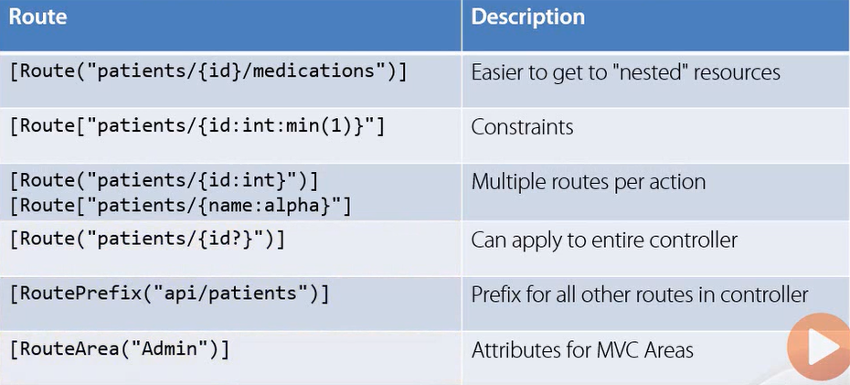
Attribute routing
Notes:
Nested resource URI was very difficult to achieve in ASP.NET Web API 1.
Nested resource URI - ./api/categories/{id}/products

Slide 13
DEMO: Attribute Routing – Nested Resource and Constraint
Notes:
Patient Data –
Patient has ailments (Name of illness)
Patient takes medications (Name and doses)
All Patients –http://localhost:57966/api/patients/
One Patient – http://localhost:57966/api/patients/52acbeff63f26e3688e35230
Nested resource with constraint (fetches only medications for resource) - http://localhost:57966/api/patients/52acbeff63f26e3688e35230/medications
Controller Code
[Route("api/patients/{id:length(24)}/medications")]
public HttpResponseMessage GetetMedications(string id)
{
var patient = _patients.FindOneById(ObjectId.Parse(id));
if (patient == null)
{
return Request.CreateErrorResponse(HttpStatusCode.NotFound, "Patient not found");
}
return Request.CreateResponse(patient.Midications);
}

Slide 14
OData

Slide 15
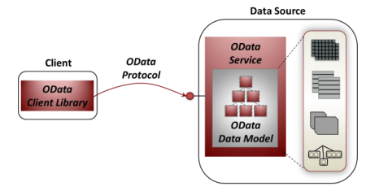
OData
The Open Data Protocol (OData) is a protocol for querying data over the web
OData protocol is a set of RESTful interactions along with an OData-defined query language based on JSON and AtomPub
Notes:
The Open Data Protocol (OData) is a Web protocol for querying and updating data over the web
Client makes requests with OData protocol to and get responses from an OData service.
OData protocol is a set of RESTful interactions that include the usual CRUD operations, along with an OData-defined query language based on JSON and AtomPub
Reference - http://www.odata.org/documentation/odata-v2-documentation/operations/

Slide 16
OData Query
$top=n: Returns only the first n entities in an entity set (or in Atom terms, the first n entries in a feed).
$skip=n: Skips the first n entities in an entity set. Using this option lets a client retrieve a series of distinct pages on subsequent requests.
$format: Determines whether data should be returned in JSON or the XML-based Atom/AtomPub format. (The default is Atom/AtomPub.)
$orderby=: Orders results, in ascending or descending order, by the value of one or more properties in those results.
$filter=: Returns only entities that match the specified expression.

Slide 17
ASP.NET Web API OData
Components for implementing OData services
Model builders, formatters (Atom/JSON/XML), path and query parsers, LINQ expression generator, etc.
Built on ODataLib
Same underpinnings as WCF Data Services
Initially shipped with Visual Studio 2012 Update 2
Now supports $select, $expand and $batch!

Slide 18
DEMO: OData – Http GET $select and $expand Http POST AtomPub
Notes:
Review Schema – Product Category and Supplier, Product belongs to Category, Supplier supplies products
OData enabled Controller
ASP.NET OData enabled Controller Scaffolding
Queryable Attribute in Controller Action
ODataController base class for controller
Fetch List - http://localhost:57966/odata/Products
Fetch based on Id - http://localhost:57966/odata/Products(3)
Fetch Selective fields - http://localhost:57966/odata/Products?$select=Price,Name
Fetch Expanded data for one product - http://localhost:57966/odata/Products(4)?$expand=Supplier
Fetch Expanded list - http://localhost:57966/odata/Products?$expand=Category,Supplier
POST –
User-Agent: Fiddler
Host: localhost:57966
Accept: application/atom+xml
content-type: application/atom+xml
AtomPub Body -
<entry xml:base="http://localhost:57966/odata" xmlns="http://www.w3.org/2005/Atom" xmlns:d="http://schemas.microsoft.com/ado/2007/08/dataservices" xmlns:m="http://schemas.microsoft.com/ado/2007/08/dataservices/metadata" xmlns:georss="http://www.georss.org/georss" xmlns:gml="http://www.opengis.net/gml">
<title />
<updated>2013-12-15T02:28:42Z</updated>
<author>
<name />
</author>
<content type="application/xml">
<m:properties>
<d:ID m:type="Edm.Int32">100</d:ID>
<d:Name>Board Game</d:Name>
<d:Price m:type="Edm.Decimal">10.00</d:Price>
<d:CategoryId m:type="Edm.Int32">26</d:CategoryId>
<d:SupplierId>WalMart</d:SupplierId>
</m:properties>
</content>
</entry>
Returns – Location URI

Slide 19
Web API Security - OAuth

Slide 20
Web API Security
Security in transit
SSL is always appropriate
Securing the API Itself
Cross domain / origin calls
Authentication and Authorization
Notes:
In Transit Security –
To protect yourself, in transit tampering, eavesdropping
SSL is always appropriate
Cost of SSL is worth the expense .. Usually
Securing the API Itself
Cross Origin Calls – If I need support only specific domain
Authentication and Authorization – Who is accessing the API and what all rights the caller has
Of course SSL is out of scope.
But, ASP.NET Web API 2 comes with specific solutions for both – CORS (Cross Origin Resource Sharing) and Authentication.
Of course Authorization techniques are out of scope and nothing is changing with respect to ASP.NET Web API 2

Slide 21
Web API Security - Authentication
Server to Server Authentication
API Keys and shared Secrets
User Proxy Authentication
OAuth or similar
Direct User Authentication
Piggyback on existing system using Cookies or Tokens
Notes:
Authentication – Who is calling the API?
Server to server Authentication – For example - my Service is talking to another service
Common approach is to go for API Key and shared secrets
This is for non user specific domains – accessing google map, weather information, ESPN public APIs, AWS (Amazon Web Services as long as I am not trying to find our what order a specific user made) etc
Truly open or Public APIs (we just needs to know which developer is accessing the data)
User Proxy Authentication
Here we may know the developer by the API key, but the API / developer is trying to access data on behalf of a specific user
Here I want to work with 3rd party API but I don’t have to be responsible for collecting and managing the user information
This is where we would use oAuth
Essentially you are proxy-ing the actual authentication
ASP.NET Web API has major update in oAuth based authentication
Finally the Direct User Authentication
Use Http based authentications like Basic / Digest / X509 digital certificate – that doesn’t change since
If you are using ASP.Net based web application with Forms authentication, then you will use the same cookie based approach API authentication
Generally, this category is your private APIs or building API for your own site

Slide 22
OAuth
For allowing other API to act as user in your system
Accept user credential
Then trust a 3rd party with a token that represents the other API
The other API never receives the credentials

Slide 23
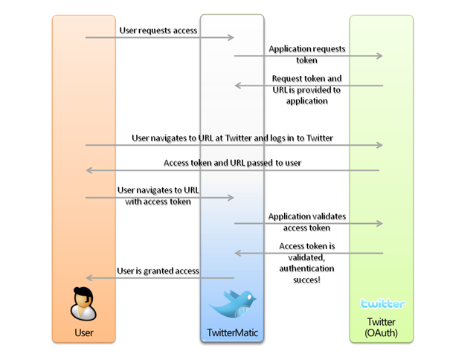
Oauth Flow

Slide 24
DEMO: SPA and OAuth
Notes:
SPA – includes OAuth with Google / Facebook / Microsoft ..etc
We just need to enable it in App_Start\Startup.Auth.cs
SPA is a API project with client
Web API project
Includes all login APIs
External Login APIs

Slide 25
Web API Security - CORS

Slide 26
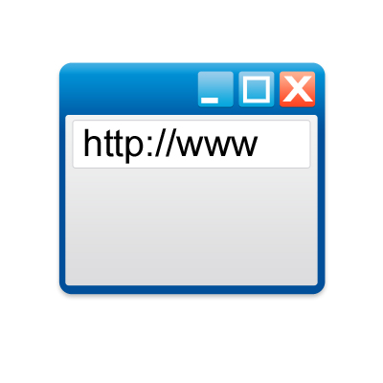

CORS - Cross Origin Resource Sharing
Http Request & Response
http://www.domain1.com
Http Request Header
Origin: domain1.com
Web Server of Domain1.com
Http Response Header
Access-Control-Allow-Origin: domain1.com
Web Server of Domain2.com
Notes:
For years Browsers blocked cross origin calls, for example: when a javascript in www.mydomain.com calls an API in www.otherdomain.com, Browser generally blocks this cross domain calls as security risk
But this is a very useful feature specially with the rapid proliferation of data services, mostly data will be available in a different domain. People used some clunky method JSONP to avoid this browser blocking.
With this new CORS support, modern browsers will allow it if the server allows by informing the client that the call is legal and allowed

Slide 27
CORS Http Headers
Request Headers:
Origin
Access-Control-Request-Method
Access-Control-Request-Headers
Response Headers
Access-Control-Allow-Origin
Access-Control-Allow-Methods
Access-Control-Allow-Headers
Access-Control-Allow-Credentials
Access-Control-Max-Age
Notes:
Unless it is simple unauthenticated GET Requests, browsers make pre-flight request to check with the server regarding –
Allowed Methods (GET / PUT / POST / PUT or others)
Allowed Http Headers (Credential allowed or not)
Reference - https://developer.mozilla.org/en-US/docs/HTTP/Access_control_CORS

Slide 28
DEMO: CORS
Notes:
Normal case –
API returns the data but browser blocks due to security reason
Client – http://localhost/CORSTest/default.html
API - http://localhost:57966/api/patients
Due to port number difference – this is a cross domain scenario.
In chrome
Network error – F12 tool
Absence of Access-Control-Allow-Origin error in chrome (Need to click the Red error icon in the right bottom corner)
Enable CORS in the PatientData API –
In App_Start in WebAPICOnfig.cs
var cors = new EnableCorsAttribute("http://localhost","*","GET");
config.EnableCors(cors);
Also Add attribute in Controller.
Run the same client – response comes

Slide 29
ASP.NET and OWIN Integration Katana Project

Slide 30
OWIN integration
OWIN = Open Web Interface for .NET (http://owin.org)
Defines a common interface that decouples web apps from web servers
Inspired by the likes of node.js, Rack, WSGI
Now deeply integrated with the ASP.NET pipeline
Ex. run authenticating middleware during the Authenticate ASP.NET pipeline stage
Run your Web APIs on any OWIN compliant host
Katana is the Microsoft’s OWIN implementation as hosting abstraction
Notes:
The ASP.NET Framework has been around for over ten years. ASP.NET and IIS together has provided very rich collection of features – caching, authentication, encryption, compression even for diagnostics and logging there multiple implementations. But not everyone needs these all features.
Let us take an example of a very simple Web API – one URI (no routing) and message processing. What we need here – HttpListener and Message Handler.
Host the application in a console application not in any web server.
It freaks people out if we misunderstand this as a replacement of ASP.NET. It doesn’t replace ASP.NET.
It started with ASP.NET Web API – self hosting.
With 2 major drivers –
As the HTML 5 is maturing, the processing power is getting shifted from server to client. That allows us to think of a lighter weight web server
With people shifting more towards cloud – every byte and CPU cycle cost lot of money. Unused software, CPU cycles, memory are just waste of money. Efficiency will save money.
Earlier ASP.NET was shipped along with Dot.Net once in a year or 2 years. But web world moves much faster – needed much quicker turn around / agility. Key assembly System.Web is very bulky. These days – NuGet packages coming up frequently.
With ASP.NTE web API is changing the world even further. Specially with REST, we really do not need lot of IIS modules.
We need a fast, extensible, easier to scale, lean host of web applications. Like LinkedIn used Node.js and HTML5 to build a better faster app. Node.js is not a web server, but a it is very easy to add a package to make it like a web application. Nothing extra is needed. Fast and lean. That’s where OWIN comes into picture.
OWIN (Open web Interface for Dot.Net)
started by a group of developers
Is a set of specifications developed on the principle to keep Web Framework and Web Server to remain decoupled
www.owin.org for more information
Katana is Microsoft’ implementations of – OWIN using Microsoft’s own components
In a MVC project, we include System.Web – which is the core of ASP.Net – includes caching, configuration through web sockets.
Instead of a large assembly, Katana features are highly modular and componentized.
Katana is the approach for a web api or web application where we do not need exhaustive features of a web server.
Web API can be hosted in any OWIN supported host.
See the difference in the browser -
OWIN based System.web - http://msdn.microsoft.com/en-us/library/system.web.aspx
- It includes HttpContextExtensions and HttpContextBaseExtensions
Old System.Web - http://msdn.microsoft.com/en-us/library/System.Web(v=vs.100).aspx
- Sitemap, caching, HttpContext, client certificates, cookie management ..everything included.
We can host Web API on Mono too. If Web API supports OWIN, it can be hosted on any OWIN compatible host. ASP.NET is OWIN supported – and we can swap out the host with any other OWIN compatible host.

Slide 31
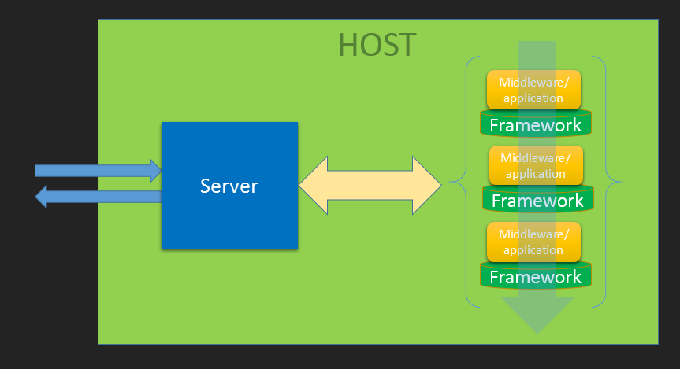
OWIN / Katana Architecture
Notes:
Instead of IIS, any windows service or a console application is the HOST. Host is the actual process owner.
Host starts the server – server interacts with the Operating system – Http listeners
Server initiates a pipeline of middleware – Auth etc
App Starts > Server Starts > Pipeline starts
Each Http Request goes through the pipeline
3 major Goals of this architecture / Katana project –
Compose -ability
Portability
Performance and Scalability

Slide 32
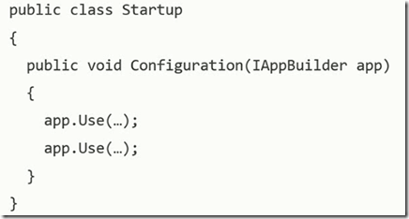
Katana Implementation
Convention over configuration
2. using AppFunc = Func<IDictionary<string, object>, Task>;
Notes:
MSDN Journal – October 2013 - http://msdn.microsoft.com/en-us/magazine/dn451439.aspx
Every component in an OWIN-based application supplies an application delegate to a server. The components are then chained together into a pipeline into which an OWIN-based server pushes requests. In order to use resources efficiently, all components in the pipeline should be asynchronous, and this is reflected in the application delegate returning a Task object.
All states, including application state, request state, server state and so forth, are held in the IDictionary<string, object> object specified on the application delegate. This data structure, known as the environment dictionary, is passed from component to component as a request progresses through the pipeline. While any key/value data may be inserted into the environment dictionary, the OWIN specification defines keys for some core elements of HTTP, as shown in Figure 1.
OWIN has a concept of middleware – that gets plugged into a pipeline – where there could be a component inserted between two different other components, each component
The stack consists of the following layers:
Host: The process that runs the application and can be anything from IIS or a standalone executable, to your own custom program. The host is responsible for startup, loading of other OWIN components and shutting down gracefully.
Server: Responsible for binding to a TCP port, constructing the environment dictionary and processing requests through an OWIN pipeline.
Middleware: The name given to all of the components that handle requests in an OWIN pipeline. It can range from a simple compression component to a complete framework such as ASP.NET Web API, though from the server’s perspective, it’s simply a component that exposes the application delegate.
Application: This is your code. Because Katana is not a replacement for ASP.NET but rather a new way to compose and host components, existing ASP.NET Web API and SignalR applications remain unchanged, as those frameworks can participate in an OWIN pipeline. In fact, for these kinds of applications, Katana components will be visible only in a small configuration class.

Slide 33
DEMO: Web API OWIN self host
Notes:
Demo to show – HttpListener –
Small Web server with Logging, Basic Authentication
Need to run the console app
Then call the Url from fiddler
With Authorization Tag and without Authorization Tag

Slide 34
Find out more
http://www.asp.net/vnext
http://www.asp.net/webapi
http://channel9.msdn.com
Follow progress in
http://aspnetwebstack.codeplex.com
http://katanaproject.codeplex.com

